Slide 1
Q2 What

Slide 2
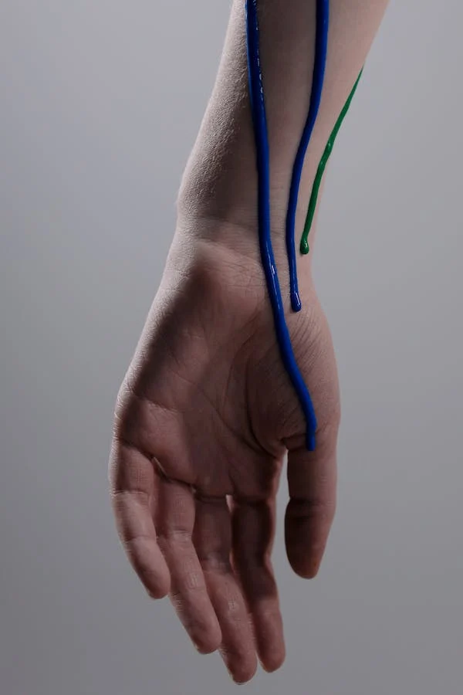
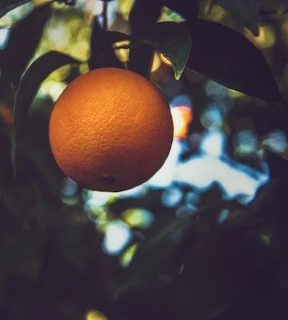
What
is dripping?
is dripping.
The paint
What
is growing?
is growing.
The orange

Slide 3
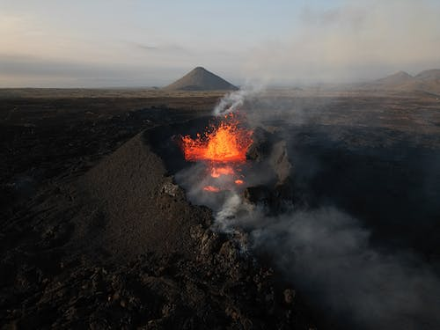
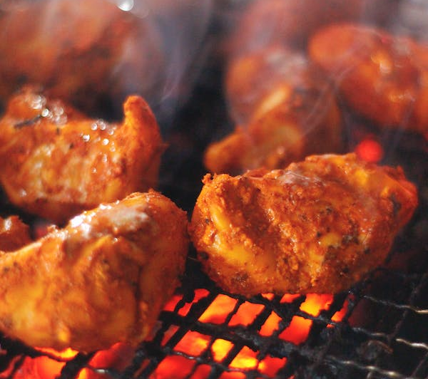
What
is sizzling?
is sizzling.
The volcano
What
is erupting?
is erupting.
The meat

Slide 4
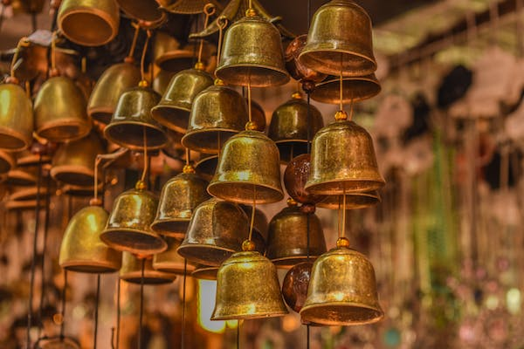
What
are ringing?
are ringing.
Bells
What
are playing?
are playing.
Dogs

