Slide 1
Q1 Who

Slide 2
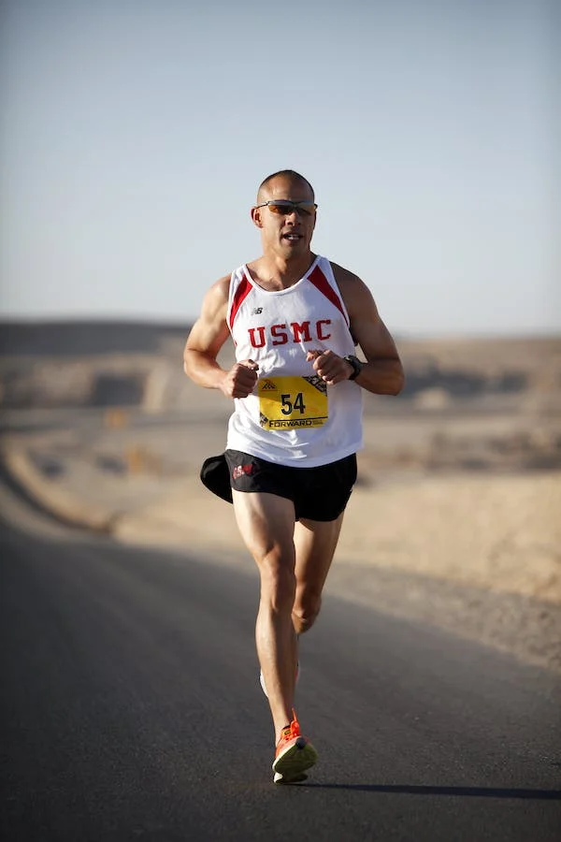
Drag the words for the person into the oval
Who
is reading?
is reading.
The man
Who
is running?
is running.
The lady

Slide 3
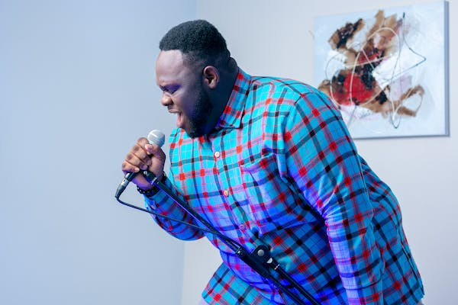
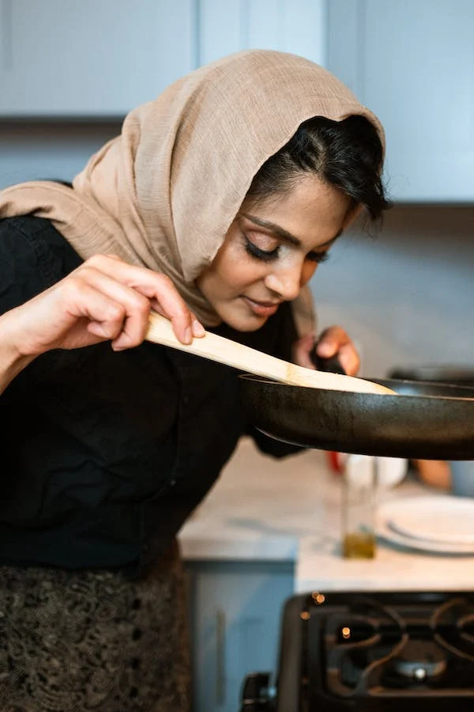
Drag the words for the person into the oval
Who
is singing?
is singing.
The man
Who
is cooking?
is cooking.
The lady

Slide 4
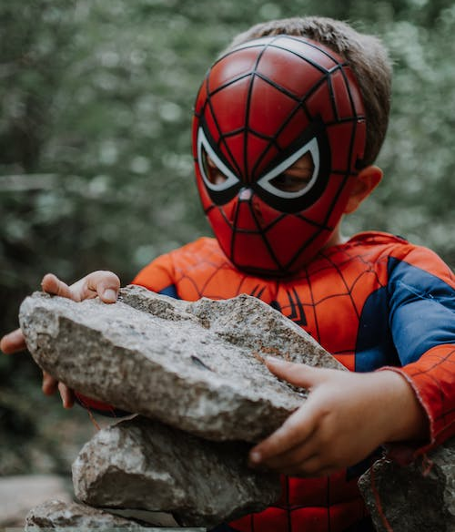
Drag the words for the person into the oval
Who
is singing?
is singing.
Santa
Who
is building?
is building.
Spiderman

