Slide 1
Creating SVO sentences to match videos

Slide 2
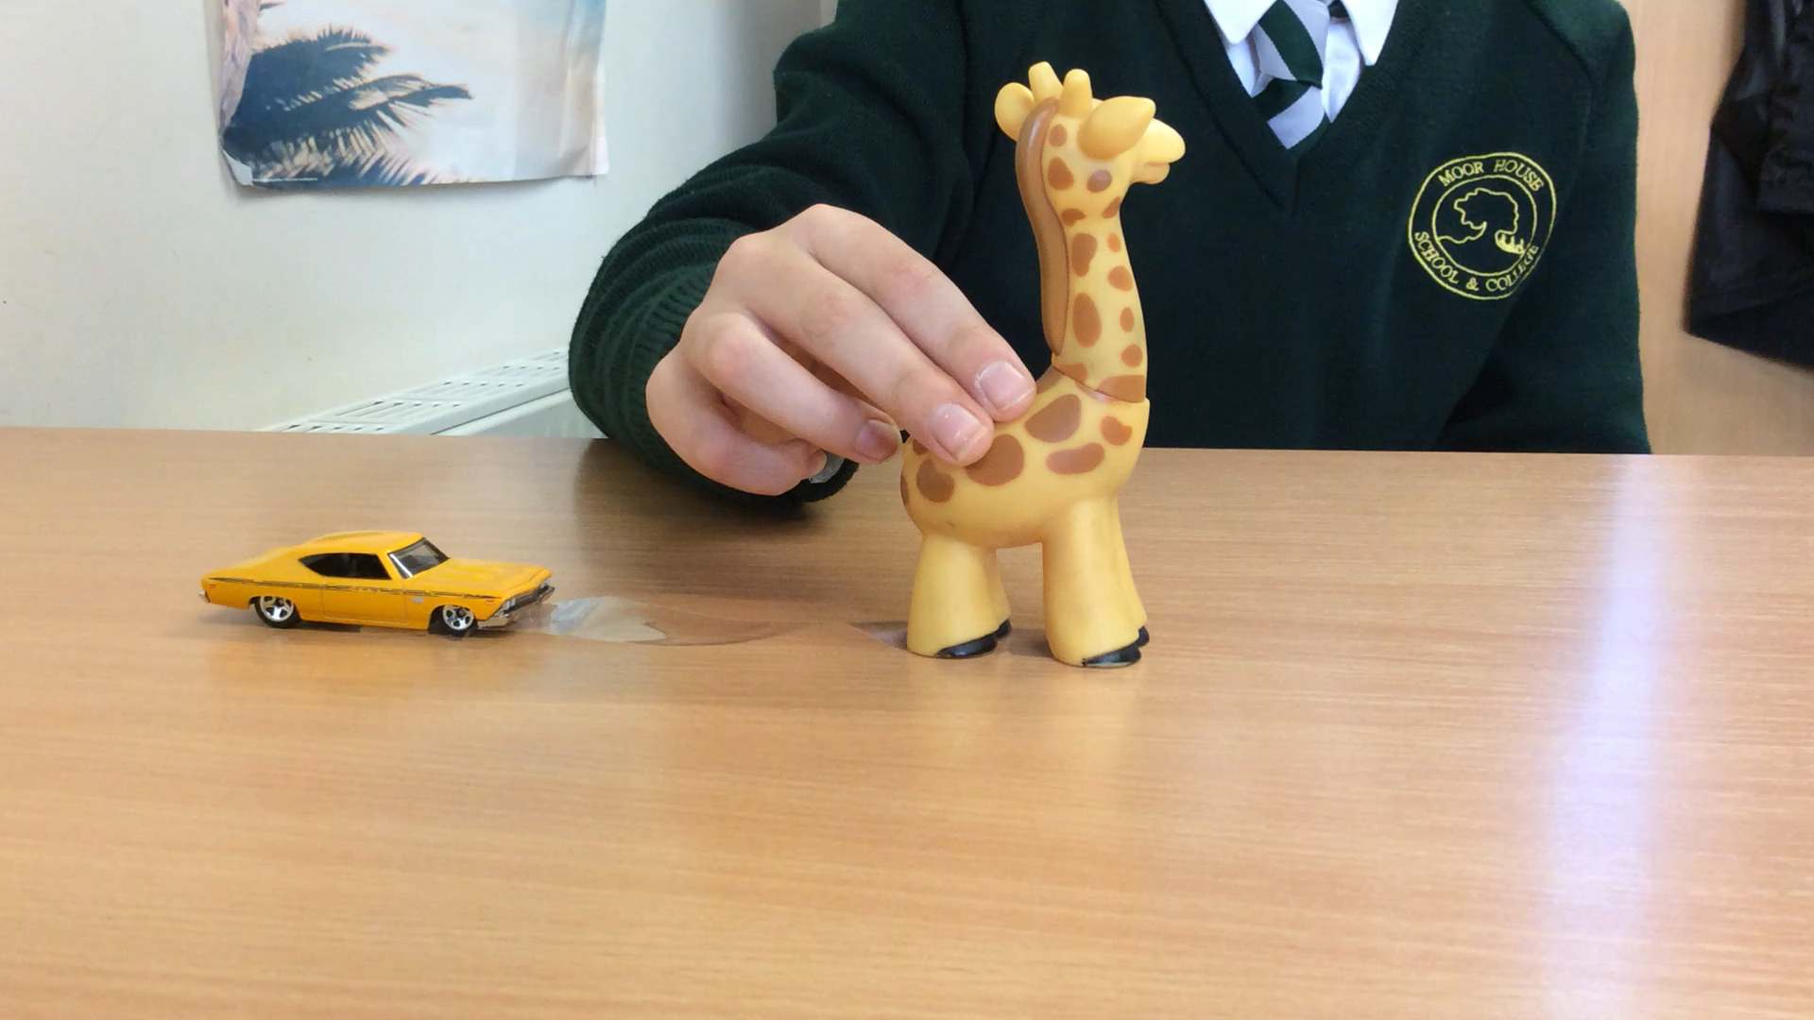
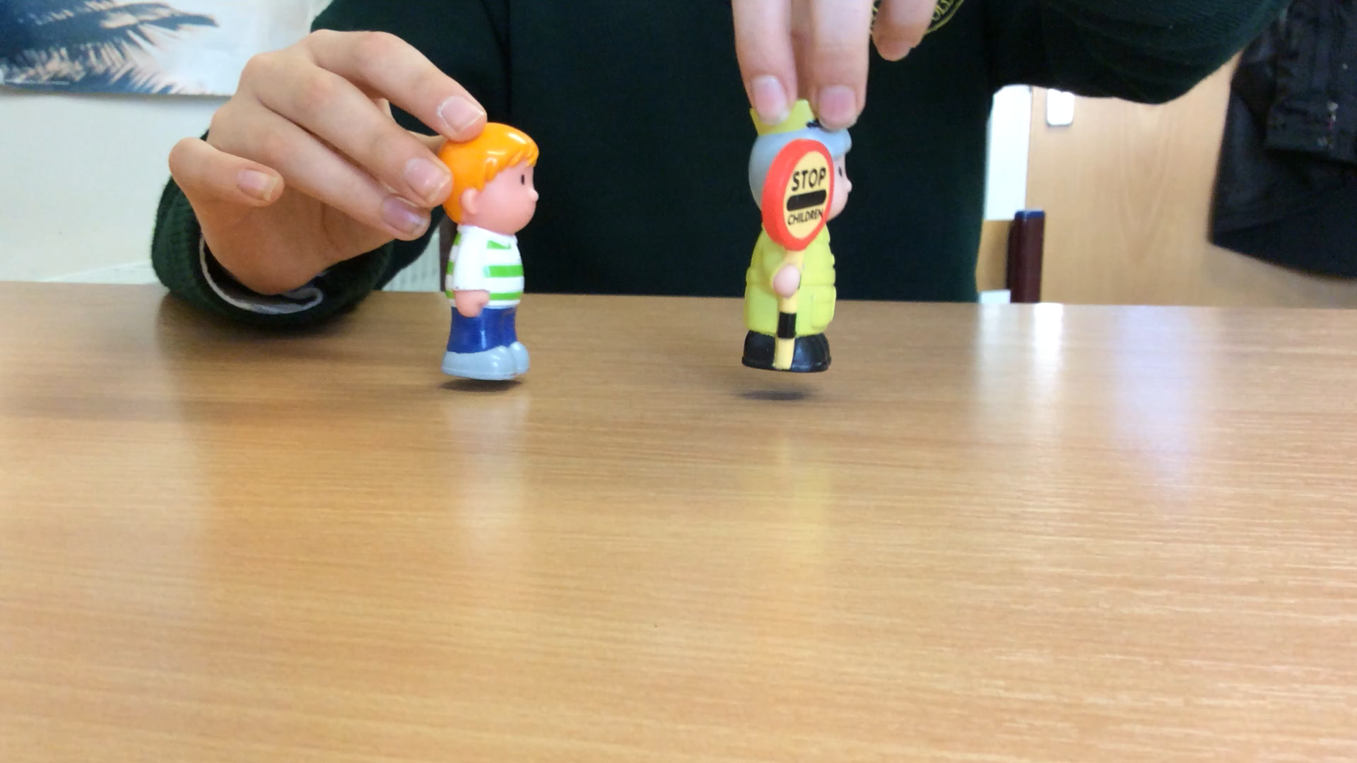
Watch the video clip. Drag the words into the correct shapes to match the clip.
is
pulling
the giraffe
the car
is
the lollipop lady
the boy
chasing

Slide 3
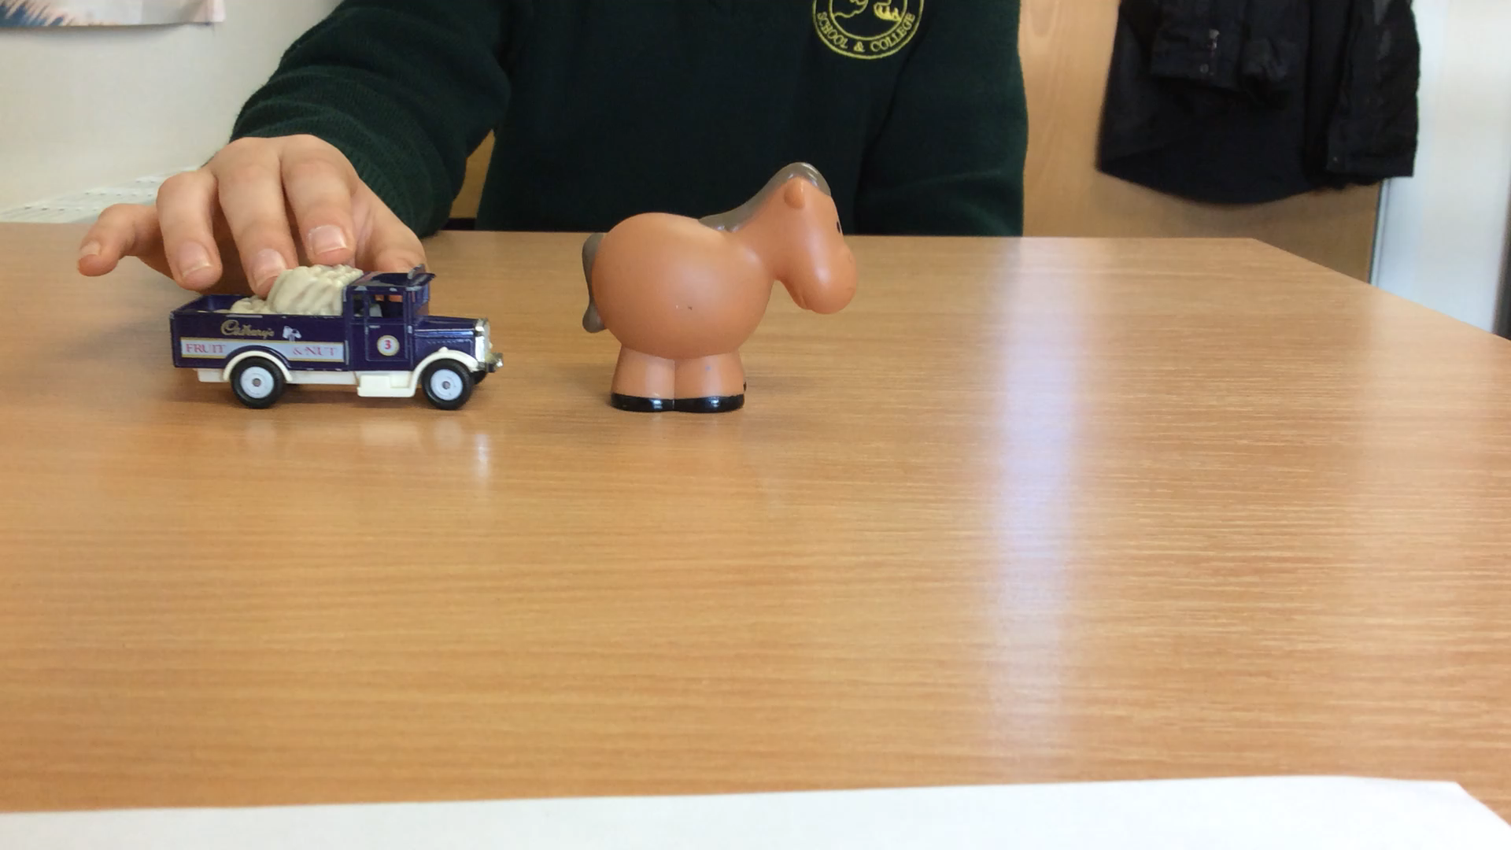
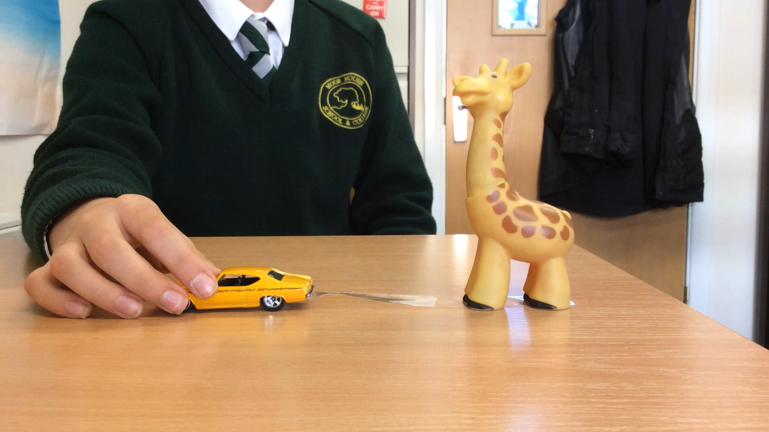
the horse
the truck
pushing
is
the giraffe
the car
towing
is

