Slide 1
Subject + Verb + Object drag and drop

Slide 2
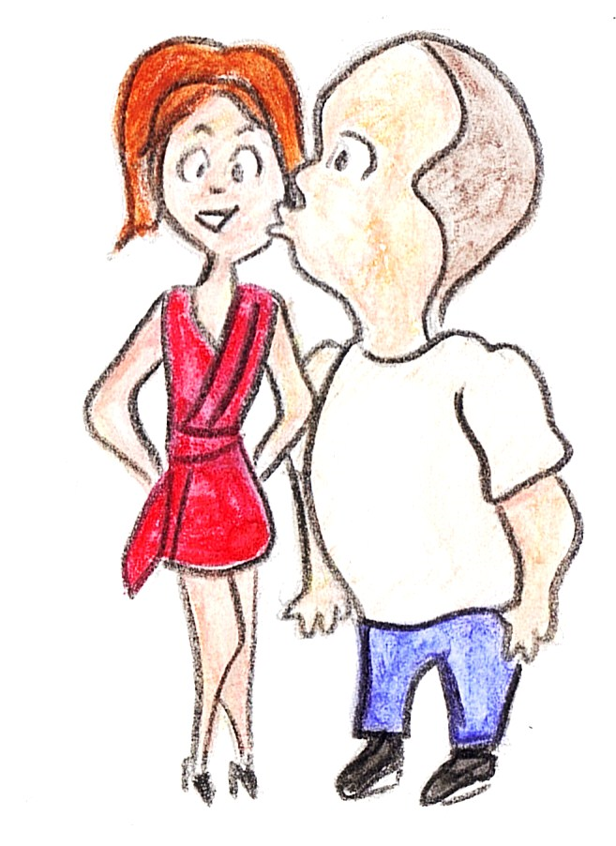
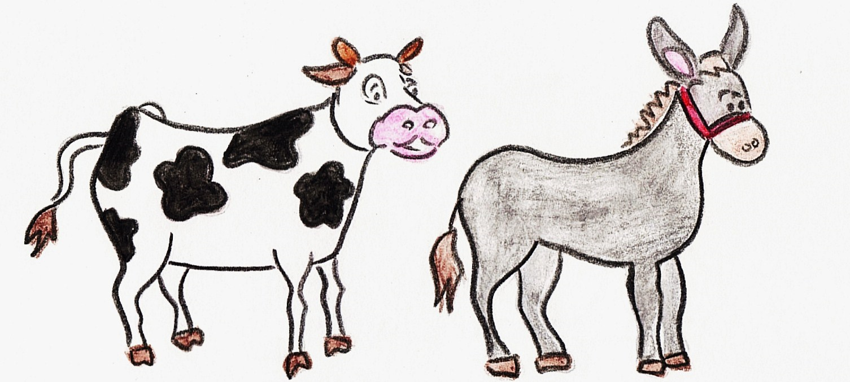
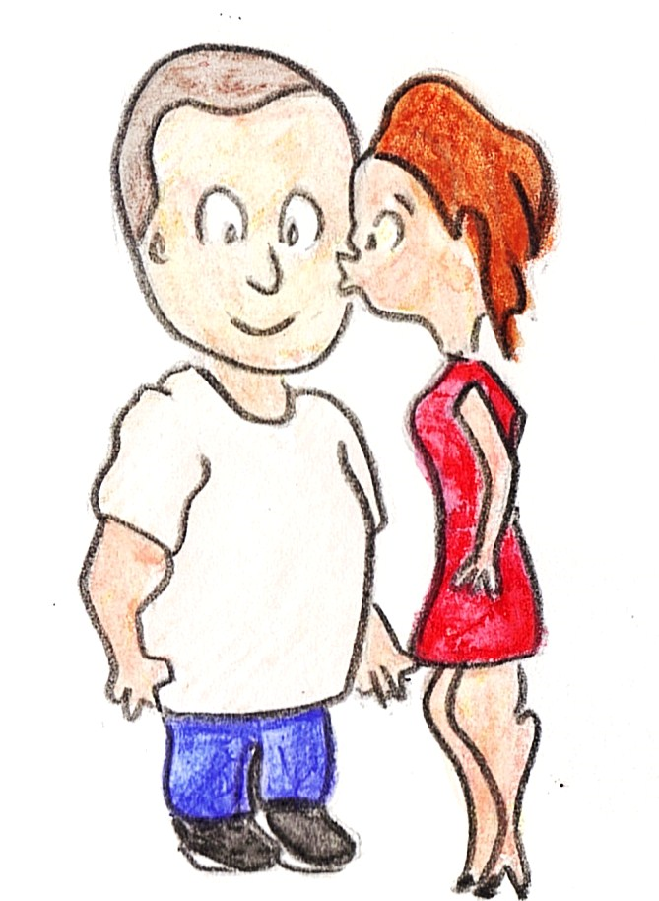
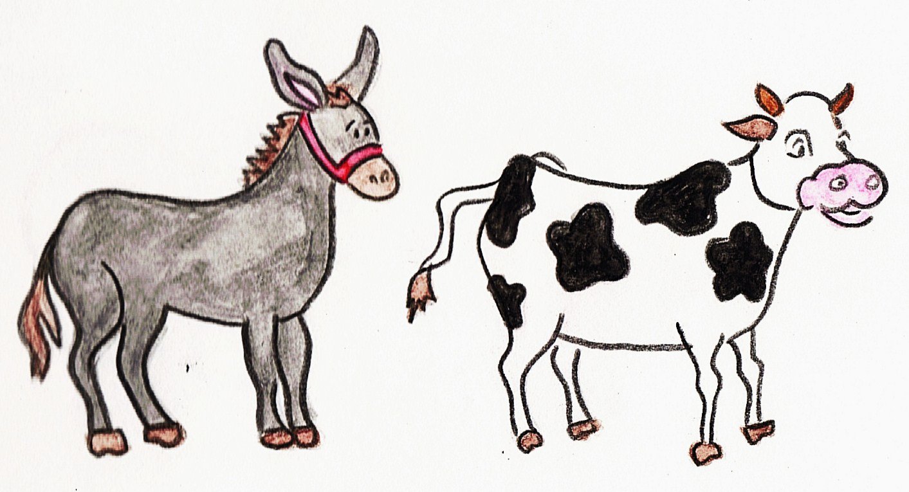
Production Task: Drag an image into each box. Then drag words into the sentence templates to match the images.
1
2
1
2
the lady
the cow
kissing
is
the man
the donkey
following
is

Slide 3
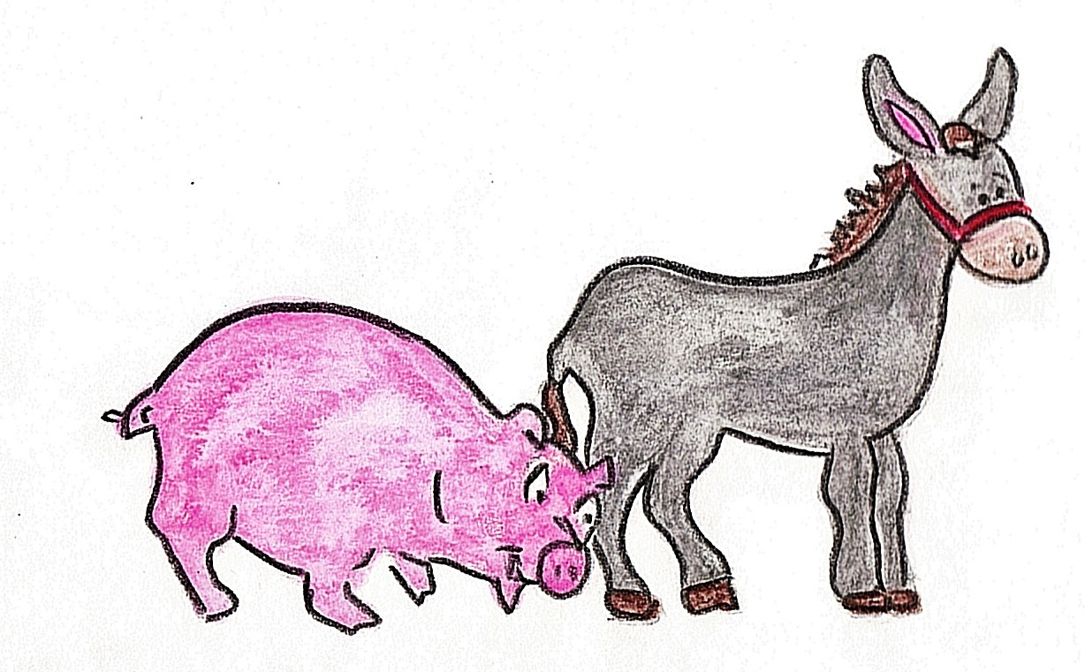
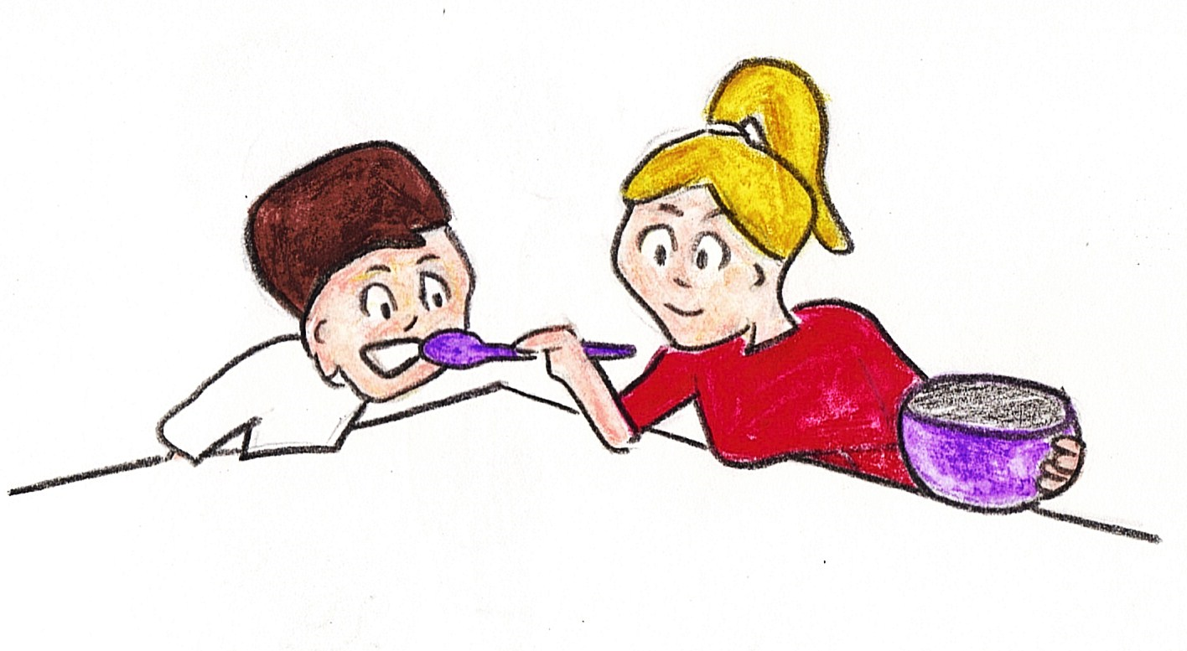
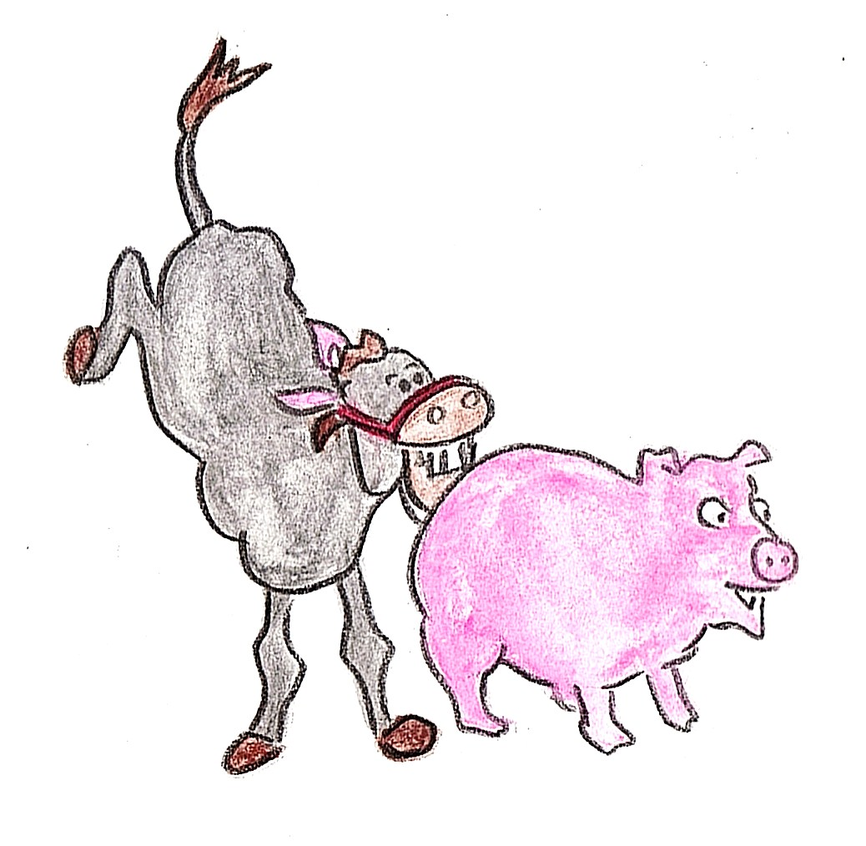
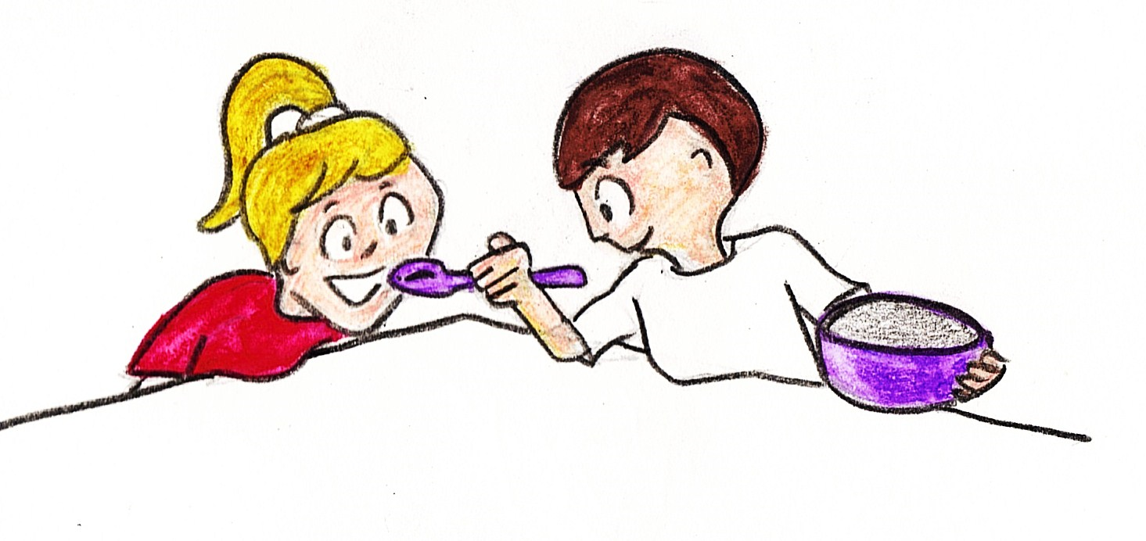
Production Task: Drag an image into each box. Then drag words into the sentence templates to match the images.
3
4
3
4
the girl
the pig
biting
is
the boy
the donkey
feeding
is

